Slide 1
Cache Design and Tricks
Presenters:
Kevin Leung
Josh Gilkerson
Albert Kalim
Shaz Husain

Slide 2
What is Cache ?
A cache is simply a copy of a small data segment residing in the main memory
Fast but small extra memory
Hold identical copies of main memory
Lower latency
Higher bandwidth
Usually several levels (1, 2 and 3)

Slide 3
Why cache is important?
Old days: CPUs clock frequency was the primary performance indicator.
Microprocessor execution speeds are improving at a rate of 50%-80% per year while DRAM access times are improving at only 5%-10% per year.
If the same microprocessor operating at the same frequency, system performance will then be a function of memory and I/O to satisfy the data requirements of the CPU.

Slide 4
Types of Cache and
Its Architecture:
There are three types of cache that are now being used:
  One on-chip with the processor, referred to as the "Level-1" cache (L1) or primary cache
  Another is on-die cache in the SRAM is the "Level 2" cache (L2) or secondary cache.
  L3 Cache
PCs and Servers, Workstations each use different cache architectures:
  PCs use an asynchronous cache
  Servers and workstations rely on synchronous cache
  Super workstations rely on pipelined caching architectures.

Slide 5
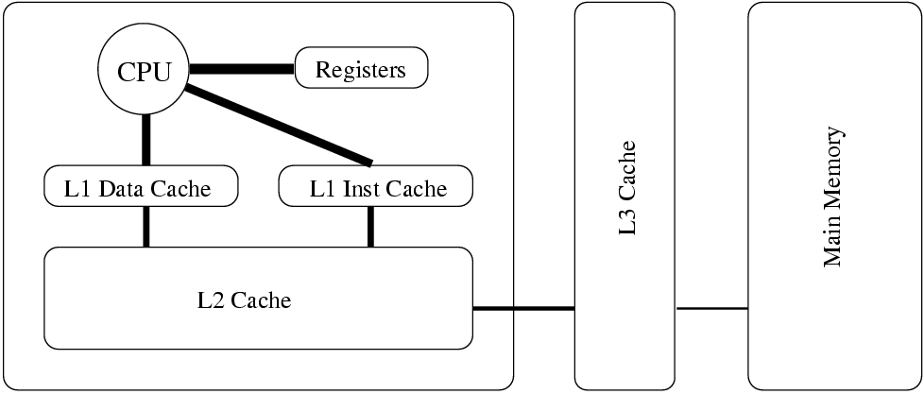
Alpha Cache Configuration

Slide 6
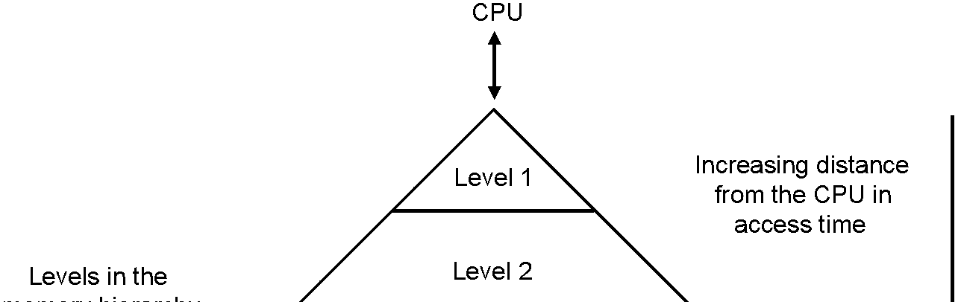
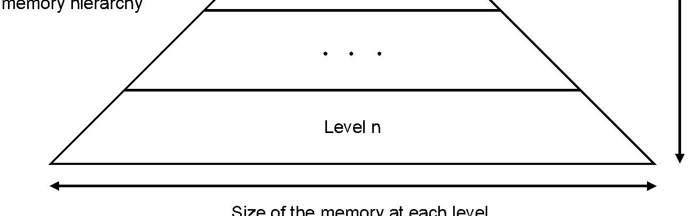
General Memory Hierarchy

Slide 7
Cache Performance
Cache performance can be measured by counting wait-states for cache burst accesses.
When one address is supplied by the microprocessor and four addresses worth of data are transferred either to or from the cache.
Cache access wait-states are occur when CPUs wait for slower cache subsystems to respond to access requests.
Depending on the clock speed of the central processor, it takes
  5 to 10 ns to access data in an on-chip cache,
  15 to 20 ns to access data in SRAM cache,
  60 to 70 ns to access DRAM based main memory,
  12 to 16 ms to access disk storage.

Slide 8
Cache Issues
Latency and Bandwidth – two metrics associated with caches and memory
Latency: time for memory to respond to a read (or write) request is too long
  CPU ~ 0.5 ns (light travels 15cm in vacuum)
  Memory ~ 50 ns
Bandwidth: number of bytes which can be read (written) per second
  CPUs with 1 GFLOPS peak performance standard: needs 24 Gbyte/sec bandwidth
  Present CPUs have peak bandwidth <5 Gbyte/sec and much less in practice

Slide 9
Cache Issues (continued)
Memory requests are satisfied from
  Fast cache (if it holds the appropriate copy): Cache Hit
  Slow main memory (if data is not in cache): Cache Miss

Slide 10
How Cache is Used?
Cache contains copies of some of Main Memory
  those storage locations recently used
    when Main Memory address A is referenced in CPU
    cache checked for a copy of contents of A
  if found, cache hit
    copy used
    no need to access Main Memory
  if not found, cache miss
    Main Memory accessed to get contents of A
    copy of contents also loaded into cache

Slide 11
Progression of Cache
Before 80386, DRAM is still faster than the CPU, so no cache is used.
  4004: 4Kb main memory.
  8008: (1971) : 16Kb main memory.
  8080: (1973) : 64Kb main memory.
  8085: (1977) : 64Kb main memory.
  8086: (1978) 8088 (1979) : 1Mb main memory.
  80286: (1983) : 16Mb main memory.

Slide 12
Progression of Cache (continued)
80386: (1986)
  80386SX:
    Can access up to 4Gb main memory
    start using external cache, 16Mb
    through a 16-bit data bus and 24 bit address bus.
80486: (1989)
  80486DX:
    Start introducing internal L1 Cache.
    8Kb L1 Cache.
    Can use external L2 Cache
Pentium: (1993)
  32-bit microprocessor, 64-bit data bus and 32-bit address bus
  16KB L1 cache (split instruction/data: 8KB each).
  Can use external L2 Cache

Slide 13
Progression of Cache (continued)
Pentium Pro: (1995)
  32-bit microprocessor, 64-bit data bus and 36-bit address bus.
  64Gb main memory.
  16KB L1 cache (split instruction/data: 8KB each).
  256KB L2 cache.
Pentium II: (1997)
  32-bit microprocessor, 64-bit data bus and 36-bit address bus.
  64Gb main memory.
  32KB split instruction/data L1 caches (16KB each).
  Module integrated 512KB L2 cache (133MHz). (on Slot)

Slide 14
Progression of Cache (continued)
Pentium III: (1999)
  32-bit microprocessor, 64-bit data bus and 36-bit address bus.
  64GB main memory.
  32KB split instruction/data L1 caches (16KB each).
  On-chip 256KB L2 cache (at-speed). (can up to 1MB)
  Dual Independent Bus (simultaneous L2 and system memory access).
Pentium IV and recent:
  L1 = 8 KB, 4-way, line size = 64
  L2 = 256 KB, 8-way, line size = 128
  L2 Cache can increase up to 2MB

Slide 15
Progression of Cache (continued)
Intel Itanium:
  L1 = 16 KB, 4-way
  L2 = 96 KB, 6-way
  L3: off-chip, size varies
Intel Itanium2 (McKinley / Madison):
  L1 = 16 / 32 KB
  L2 = 256 / 256 KB
  L3: 1.5 or 3 / 6 MB

Slide 16
Cache Optimization
General Principles
  Spatial Locality
  Temporal Locality
Common Techniques
  Instruction Reordering
  Modifying Memory Access Patterns
Many of these examples have been adapted from the ones used by Dr. C.C. Douglas et al in previous presentations.

Slide 17
Optimization Principles
In general, optimizing cache usage is an exercise in taking advantage of locality.
2 types of locality
  spatial
  temporal

Slide 18
Spatial Locality
Spatial locality refers to accesses close to one another in position.
Spatial locality is important to the caching system because contiguous cache lines are loaded from memory when the first piece of that line is loaded.
Subsequent accesses within the same cache line are then practically free until the line is flushed from the cache.
Spatial locality is not only an issue in the cache, but also within most main memory systems.

Slide 19
Temporal Locality
Temporal locality refers to 2 accesses to a piece of memory within a small period of time.
The shorter the time between the first and last access to a memory location the less likely it will be loaded from main memory or slower caches multiple times.

Slide 20
Optimization Techniques
Prefetching
Software Pipelining
Loop blocking
Loop unrolling
Loop fusion
Array padding
Array merging

Slide 21
Prefetching
Many architectures include a prefetch instruction that is a hint to the processor that a value will be needed from memory soon.
When the memory access pattern is well defined and the programmer knows many instructions ahead of time, prefetching will result in very fast access when the data is needed.

Slide 22
Prefetching (continued)
It does no good to prefetch variables that will only be written to.
The prefetch should be done as early as possible. Getting values from memory takes a LONG time.
Prefetching too early, however will mean that other accesses might flush the prefetched data from the cache.
Memory accesses may take 50 processor clock cycles or more.
for(i=0;i<n;++i){
a[i]=b[i]*c[i];
prefetch(b[i+1]);
prefetch(c[i+1]);
//more code
}

Slide 23
Software Pipelining
Takes advantage of pipelined processor architectures.
Affects similar to prefetching.
Order instructions so that values that are “cold” are accessed first, so their memory loads will be in the pipeline and instructions involving “hot” values can complete while the earlier ones are waiting.

Slide 24
Software Pipelining (continued)
for(i=0;i<n;++i){
a[i]=b[i]+c[i];
}
II
se=b[0];te=c[0];
for(i=0;i<n-1;++i){
so=b[i+1];
to=b[i+1];
a[i]+=se+te;
se=so;te=to;
}
a[n-1]+=so+to;
These two codes accomplish the same tasks.
The second, however uses software pipelining to fetch the needed data from main memory earlier, so that later instructions that use the data will spend less time stalled.

Slide 25
Loop Blocking
Reorder loop iteration so as to operate on all the data in a cache line at once, so it needs only to be brought in from memory once.
For instance if an algorithm calls for iterating down the columns of an array in a row-major language, do multiple columns at a time. The number of columns should be chosen to equal a cache line.

Slide 26
Loop Blocking (continued)
// r has been set to 0 previously.
// line size is 4*sizeof(a[0][0]).
I
for(i=0;i<n;++i)
for(j=0;j<n;++j)
for(k=0;k<n;++k)
r[i][j]+=a[i][k]*b[k][j];
II
for(i=0;i<n;++i)
for(j=0;j<n;j+=4) for(k=0;k<n;++k)
for(l=0;l<4;++l)
for(m=0;m<4;++m)
r[i][j+l]+=a[i][k+m]*
b[k+m][j+l];
These codes perform a straightforward matrix multiplication r=z*b.
The second code takes advantage of spatial locality by operating on entire cache lines at once instead of elements.

Slide 27
Loop Unrolling
Loop unrolling is a technique that is used in many different optimizations.
As related to cache, loop unrolling sometimes allows more effective use of software pipelining.

Slide 28
Loop Fusion
Combine loops that access the same data.
Leads to a single load of each memory address.
In the code to the left, version II will result in N fewer loads.
I
for(i=0;i<n;++i)
a[i]+=b[i];
for(i=0;i<n;++i)
a[i]+=c[i];
II
for(i=0;i<n;++i)
a[i]+=b[i]+c[i];

Slide 29
Array Padding
//cache size is 1M
//line size is 32 bytes
//double is 8 bytes
I
int size = 1024*1024;
double a[size],b[size];
for(i=0;i<size;++i){
a[i]+=b[i];
}
II
int size = 1024*1024;
double a[size],pad[4],b[size];
for(i=0;i<size;++i){
a[i]+=b[i];
}
Arrange accesses to avoid subsequent access to different data that may be cached in the same position.
In a 1-associative cache, the first example to the left will result in 2 cache misses per iteration.
While the second will cause only 2 cache misses per 4 iterations.

Slide 30
Array Merging
Merge arrays so that data that needs to be accessed at once is stored together
Can be done using struct(II) or some appropriate addressing into a single large array(III).
double a[n], b[n], c[n];
for(i=0;i<n;++i)
a[i]=b[i]*c[i];
II
struct { double a,b,c; } data[n];
for(i=0;i<n;++i)
data[i].a=data[i].b*data[i].c;
III
double data[3*n];
for(i=0;i<3*n;i+=3)
data[i]=data[i+1]*data[i+2];

Slide 31
Pitfalls and Gotchas
Basically, the pitfalls of memory access patterns are the inverse of the strategies for optimization.
There are also some gotchas that are unrelated to these techniques.
  The associativity of the cache.
  Shared memory.
Sometimes an algorithm is just not cache friendly.

Slide 32
Problems From Associativity
When this problem shows itself is highly dependent on the cache hardware being used.
It does not exist in fully associative caches.
The simplest case to explain is a 1-associative cache.
If the stride between addresses is a multiple of the cache size, only one cache position will be used.

Slide 33
Shared Memory
It is obvious that shared memory with high contention cannot be effectively cached.
However it is not so obvious that unshared memory that is close to memory accessed by another processor is also problematic.
When laying out data, complete cache lines should be considered a single location and should not be shared.

Slide 34
Optimization Wrapup
Only try once the best algorithm has been selected. Cache optimizations will not result in an asymptotic speedup.
If the problem is too large to fit in memory or in memory local to a compute node, many of these techniques may be applied to speed up accesses to even more remote storage.

Slide 35
Case Study: Cache Design for
Embedded Real-Time Systems
Based on the paper presented at the Embedded Systems Conference, Summer 1999, by Bruce Jacob, ECE @ University of Maryland at College Park.

Slide 36
Case Study (continued)
Cache is good for embedded hardware architectures but ill-suited for software architectures.
Real-time systems disable caching and schedule tasks based on worst-case memory access time.

Slide 37
Case Study (continued)
Software-managed caches: benefit of caching without the real-time drawbacks of hardware-managed caches.
Two primary examples: DSP-style (Digital Signal Processor) on-chip RAM and Software-managed Virtual Cache.

Slide 38
DSP-style on-chip RAM
Forms a separate namespace from main memory.
Instructions and data only appear in memory if software explicit moves them to the memory.

Slide 39
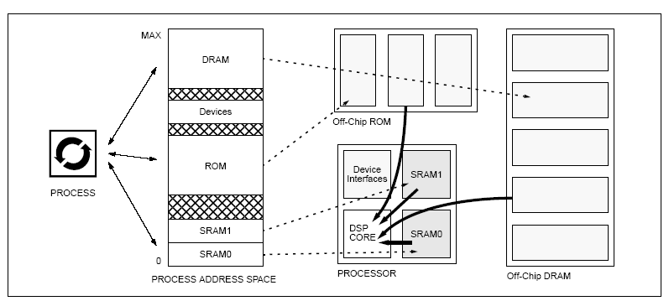
DSP-style on-chip RAM (continued)
DSP-style SRAM in a distinct namespace separate from main memory

Slide 40
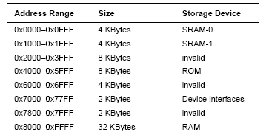
DSP-style on-chip RAM (continued)
Suppose that the memory areas have the following sizes and correspond to the following ranges in the address space:

Slide 41
DSP-style on-chip RAM (continued)
If a system designer wants a certain function that is initially held in ROM to be located in the very beginning of the SRAM-1 array:
void function();
char *from = function; // in range 4000-5FFF
char *to = 0x1000; // start of SRAM-1 array
memcpy(to, from, FUNCTION_SIZE);

Slide 42
DSP-style on-chip RAM (continued)
This software-managed cache organization works because DSPs typically do not use virtual memory. What does this mean? Is this “safe”?
Current trend: Embedded systems to look increasingly like desktop systems: address-space protection will be a future issue.

Slide 43
Software-Managed
Virtual Caches
Make software responsible for cache-fill and decouple the translation hardware. How?
Answer: Use upcalls to the software that happen on cache misses: every cache miss would interrupt the software and vector to a handler that fetches the referenced data and places it into the cache.

Slide 44
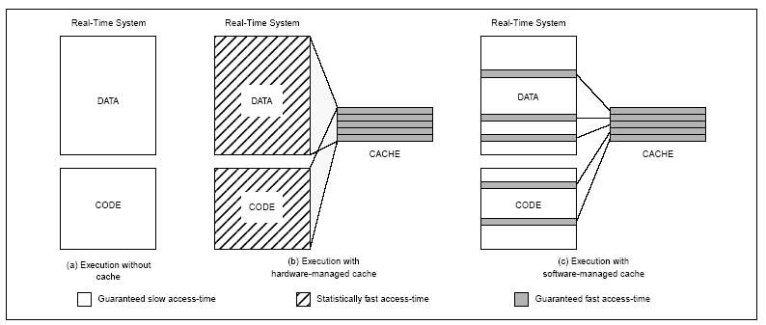
Software-Managed
Virtual Caches (continued)
The use of software-managed virtual caches in a real-time system

Slide 45
Software-Managed
Virtual Caches (continued)
Execution without cache: access is slow to every location in the system’s address space.
Execution with hardware-managed cache: statistically fast access time.
Execution with software-managed cache:
* software determines what can and cannot be cached.
* access to any specific memory is consistent (either
always in cache or never in cache).
* faster speed: selected data accesses and instructions
execute 10-100 times faster.

Slide 46
Cache in Future
Performance determined by memory system speed
Prediction and Prefetching technique
Changes to memory architecture

Slide 47
Prediction and Prefetching
Two main problems need be solved
Memory bandwidth (DRAM, RAMBUS)
Latency (RAMBUS AND DRAM-60 ns)
For each access, following access is stored in memory.

Slide 48
Issues with Prefetching
Accesses follow no strict patterns
Access table may be huge
Prediction must be speedy

Slide 49
Issues with Prefetching (continued)
Predict block addressed instead of individual ones.
Make requests as large as the cache line
Store multiple guesses per block.

Slide 50
The Architecture
On-chip Prefetch Buffers
Prediction & Prefetching
Address clusters
Block Prefetch
Prediction Cache
Method of Prediction
Memory Interleave

Slide 51
Effectiveness
Substantially reduced access time for large scale programs.
Repeated large data structures.
Limited to one prediction scheme.
Can we predict the future 2-3 accesses ?

Slide 52
Summary
Importance of Cache
System performance from past to present
  Gone from CPU speed to memory
The youth of Cache
  L1 to L2 and now L3
Optimization techniques.
  Can be tricky
  Applied to access remote storage

Slide 53
Summary Continued …
Software and hardware based Cache
  Software - consistent, and fast for certain accesses
  Hardware – not so consistent, no or less control over decision to cache
AMD announces Dual Core technology ‘05

Slide 54
References
Websites:
Computer World
http://www.computerworld.com/
Intel Corporation
http://www.intel.com/
SLCentral
http://www.slcentral.com/

Slide 55
References (continued)
Publications:
[1] Thomas Alexander. A Distributed Predictive Cache for High Performance Computer Systems. PhD thesis, Duke University, 1995.
[2] O.L. Astrachan and M.E. Stickel. Caching and lemmatizing in model elimination theorem provers. In Proceedings of the Eleventh International Conference on Automated Deduction. Springer Verlag, 1992.
[3] J.L Baer and T.F Chen. An effective on chip preloading scheme to reduce data access penalty. SuperComputing `91, 1991.
[4] A. Borg and D.W. Wall. Generation and analysis of very long address traces. 17th ISCA, 5 1990.
[5] J. V. Briner, J. L. Ellis, and G. Kedem. Breaking the Barrier of Parallel Simulation of Digital Systems. Proc. 28th Design Automation Conf., 6, 1991.

Slide 56
References (continued)
Publications:
[6] H.O Bugge, E.H. Kristiansen, and B.O Bakka. Trace-driven simulation for a two-level cache design on the open bus system. 17th ISCA, 5 1990.
[7] Tien-Fu Chen and J.-L. Baer. A performance study of software and hardware data prefetching scheme. Proceedings of 21 International Symposium on Computer Architecture, 1994.
[8] R.F Cmelik and D. Keppel. SHADE: A fast instruction set simulator for execution proling Sun Microsystems, 1993.
[9] K.I. Farkas, N.P. Jouppi, and P. Chow. How useful are non-blocking loads, stream buers and speculative execution in multiple issue processors. Proceedings of 1995 1st IEEE Symposium on High Performance Computer Architecture, 1995.

Slide 57
References (continued)
Publications:
[10] J.W.C. Fu, J.H. Patel, and B.L. Janssens. Stride directed prefetching in scalar processors . SIG-MICRO Newsletter vol.23, no.1-2 p.102-10 , 12 1992.
[11] E. H. Gornish. Adaptive and Integrated Data Cache Prefetching for Shared-Memory Multiprocessors. PhD thesis, University of Illinois at Urbana-Champaign, 1995.
[12] M.S. Lam. Locality optimizations for parallel machines . Proceedings of International Conference on Parallel Processing: CONPAR '94, 1994.
[13] M.S Lam, E.E. Rothberg, and M.E. Wolf. The cache performance and optimization of block algorithms. ASPLOS IV, 4 1991.
[14] MCNC. Open Architecture Silicon Implementation Software User Manual. MCNC, 1991.
[15] T.C. Mowry, M.S Lam, and A. Gupta. Design and Evaluation of a Compiler Algorithm for Prefetching. ASPLOS V, 1992.

Slide 58
References (continued)
Publications:
[16] Betty Prince. Memory in the fast lane. IEEE Spectrum, 2 1994.
[17] Ramtron. Speciality Memory Products. Ramtron, 1995.
[18] A. J. Smith. Cache memories. Computing Surveys, 9 1982.
[19] The SPARC Architecture Manual, 1992.
[20] W. Wang and J. Baer. Efficient trace-driven simulation methods for cache performance analysis. ACM Transactions on Computer Systems, 8 1991.
[21] Wm. A. Wulf and Sally A. McKee. Hitting the MemoryWall: Implications of the Obvious . Computer Architecture News, 12 1994.

